Slide 1
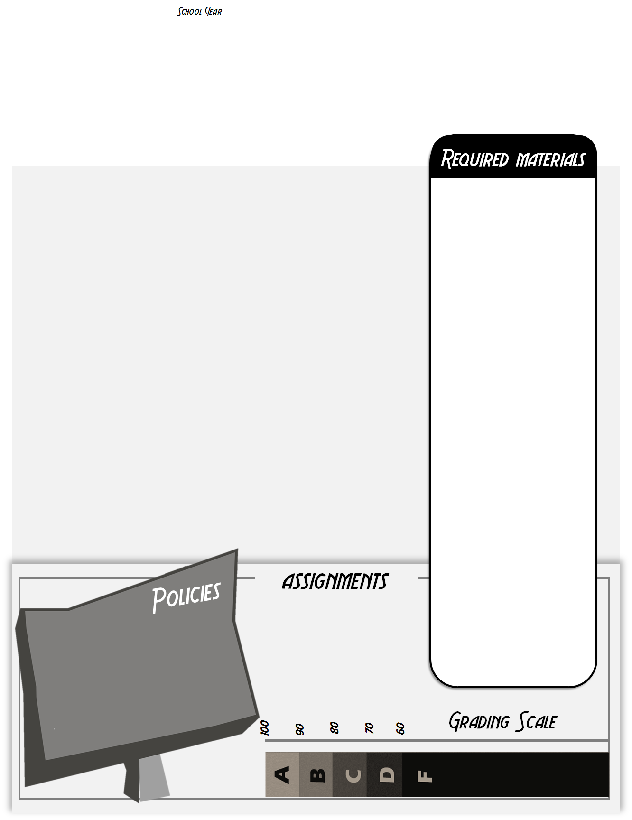
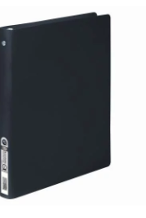
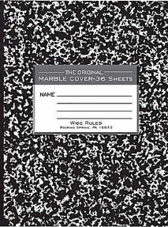
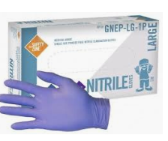
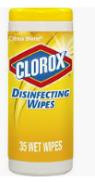
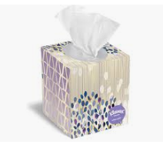
2019-2020
PLTW Principles of Biomedical Science
Mrs. Jennifer Deschaine
Course Access: my.pltw.org Email: Jenn.Deschaine@hayscisd.net
This course sets the foundation for understanding Biomedical Sciences. We will begin with a Forensics unit surrounding the death of Anna Garcia. We will then explore nutrition and diabetes, genetics and sickle cell disease, heart anatomy and function, and finally infectious diseases. You will learn how to act as a Biomedical Scientist, developing important laboratory skills in addition to your content understanding.
*1 “ Binder
*1 notebook
For a Career and Laboratory Journal *Will be provided
Notebook paper
The general rules that will apply are as follows:
All work will be given a specific due date. Work turned in after the due date and time will be counted late. 2 days turn in or ZERO
If you are absent, it is YOUR responsibility to check the Google Classroom for the work you missed, the bin for handouts, and ask questions or arrange a time to make up any lab work
You have the same number of days you missed to make up the work.
Extra-curricular activities: Get work in advance!
Online Access
Blue or Black Pen and a Pencil
Pens for raw data and lab work. Pencils for diagramming.
This class has no textbook. Instead, all curriculum is online and we use web resources and lab work to learn. You can access the curriculum at my.pltw.org. We have laptops for use in class. You are expected to stay on appropriate sites and using your time to work on the specific task/activity that has been assigned.
Additional Supplies
We will be using the following items throughout the year. Please pick on of the following items to donate to classroom. (Kleenex, Latex free Gloves, or Clorox wipes
The best way to stay connected is by checking in to the Google classroom daily, regardless of whether you are at school. You can also access curriculum using Inkling, and other free apps. SEE BELOW 🡻
Google Code:_________
Major grades = 60%
Daily grades = 40%
Late work: maximum grade = 70%
Missing work = 0 (MSG in gradebook)
Re-test : Must attend tutoring w/ max grade of 70%. 5 days to re-test
NO CHEATING: no copying work from other students or from the internet. This will result in a 0.
Personal Electronic Devices are not allowed unless specified.
Absolutely NO food or drink
NO horseplay in classroom.
Respect the people.
Respect the process.
If you have a smartphone please download these free Apps Inkling CamScanner, Google Drive, Classroom and for capturing hand-written work.

Slide 2
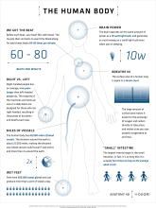
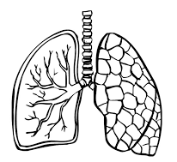
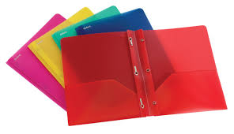
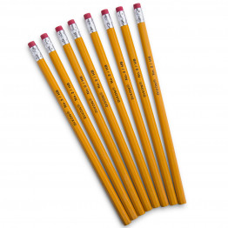
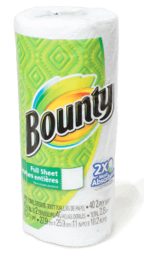
2019-2020
Human Body Systems
Mrs. Deschaine
Classroom Google Code: jenn.Deschaine@hayscisd.net 512-268-8512 ext 44463
We will explore the body’s response to extreme environments and situations, reading and analyzing “Surviving the Extremes.” We’ll figure out what makes all human bodies the same, and what makes each unique. We’ll study the different body systems, their organs and their function, utilizing dissections and manikin builds to deepen our understanding. We’ll study the body through the lenses of Identity, Communication, Power, Movement, Protection & Homeostasis.
You will need the following materials DAILY
Composition Book
*provided*
Folder
Pencils
Colored pens
If you are absent, it is YOUR responsibility to check Google Classroom and the gradebook for the work you missed.
Check with another student about what you missed.
Check with Burgess once you have an idea of the work that was missed. Ask for any handouts and clarify directions/due dates.
If you have questions, need to make up a lab or need help, arrange a time to come in outside of school.
Internet & Classroom Google
Please bring the following materials by the end of the first week
There is not a textbook for this class. Instead, all curriculum is online. We use web resources and lab work to learn. You can access the curriculum through myPLTW.org, Inkling Axis app and on our Google classroom.
Baby Wipes
or
Kleenex
or
a roll of paper towels
The best way to stay connected is by logging onto Classroom Google and the gradebook. Students and parents can sign up for Google Classroom and gradebook notifications. If you need help, feel free to ask me.
Major grades = 60%
Daily grades = 40%
Late work: maximum grade = 70%
Missing work = 0 (MSG in gradebook)
Re-test : Must attend tutoring w/ max grade of 70%. 5 days to re-test
NO CHEATING: no copying work from other students or from the internet. This will result in a 0.
If you have a smartphone please download these free apps— Google Classroom, Google Drive, Gmail, Inkling Axis.

